Slide 1
Dump Components (Presentational Components)
Concerned only with how things look (UI).
Receive data and callbacks exclusively via props.
Have little or no internal state (except for UI-specific state like form input values).
Do not directly interact with the application logic (e.g., fetching data).
Can be reused across different parts of the application.
Typically written as function components or stateless components.

Slide 2
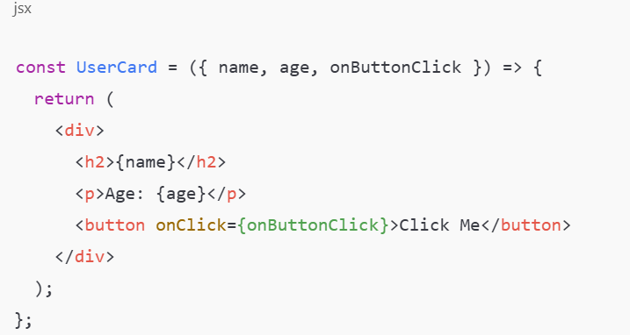
Dump Components
Here
UserCard only displays the UI based on the props it receives
It doesn’t manage any data fetching or application logic.

Slide 3
Smart Components (Container Components)
Concerned with how things work (application logic).
Handle state, side effects, and data fetching.
Pass data and callbacks to dump components via props.
Usually interact with APIs, Redux, or other state management systems.
Typically written as class components or function components with hooks.

Slide 4
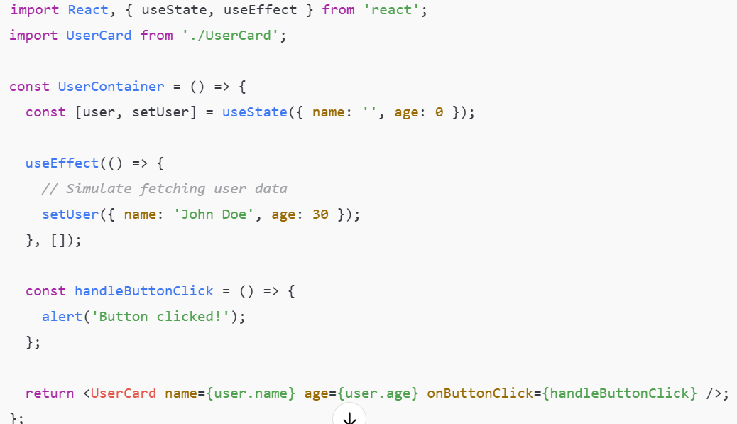
Smart Components (Container Components)
Here
UserContainer handles the state and side effects (fetching user data).
It passes the necessary data and callbacks to UserCard, a dump component.

Slide 5
Smart Components (Container Components)
Aspect | Dump Components | Smart Components
Purpose | Display UI | Handle logic and state
State | Minimal or none | Maintain application state
Data Fetching | None | Yes
Interaction | Via props | Directly interacts with services
Reusability | High | Low to moderate
Component Type | Function components | Class components or function components with hooks

